Slide 1
WELCOME NATIONAL BIG DIPPER MEMBERSHIP BODY
Thank you for your patience
while we set up
our Meeting presentation for today.

Slide 2
NATIONAL CONVENTION 2022
– LONG BEACH
National Big Dipper
71st convention

Slide 4
Preamble
For God, our country and sons and daughters, we pledge ourselves to assist in furthering the objects and purposes of our parent organization, Blue Star Mothers of America, Inc., to preserve harmony, good will, cooperation and closer fellowship among its members, we so unite to establish a permanent “Fun organization”.

Slide 5
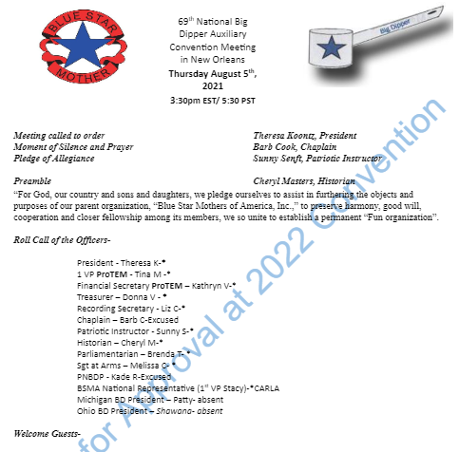
MINUTES 2021-2022

Slide 6
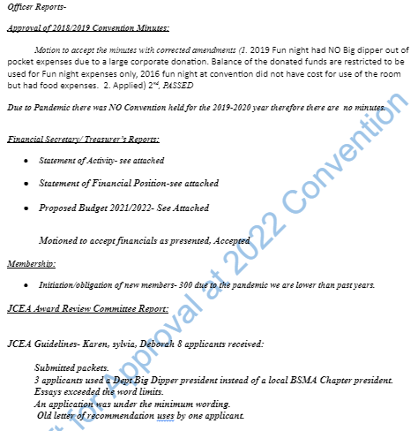
MINUTES 2021-2022

Slide 7
MINUTES 2021-2022

Slide 8
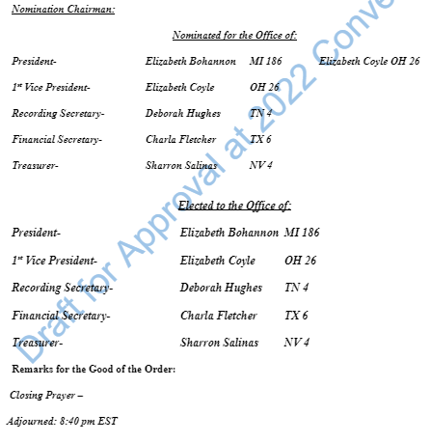
MINUTES 2021-2022

Slide 9
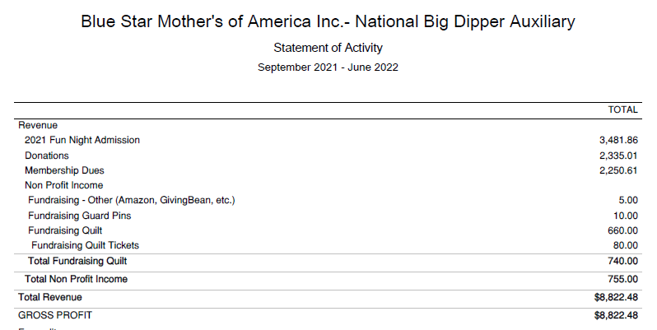
Statement of Activities
2021-2022 thru 6/30/22

Slide 10
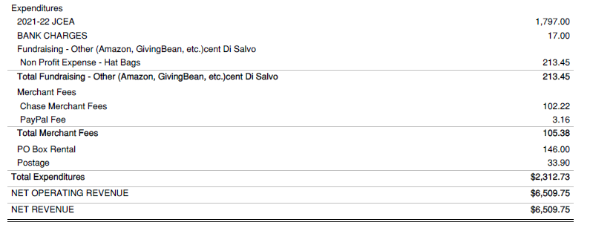
Statement of Activities Continued
2021-2022 thru 6/30/22

Slide 11
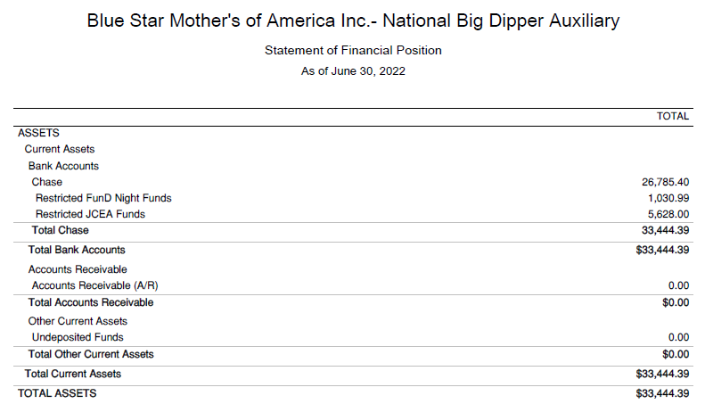
STATEMENT OF FINANCIAL POSITION 2021-2022

Slide 12
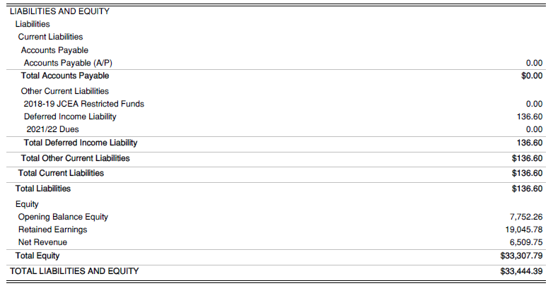
STATEMENT OF FINANCIAL POSITION CONTINUED

Slide 13
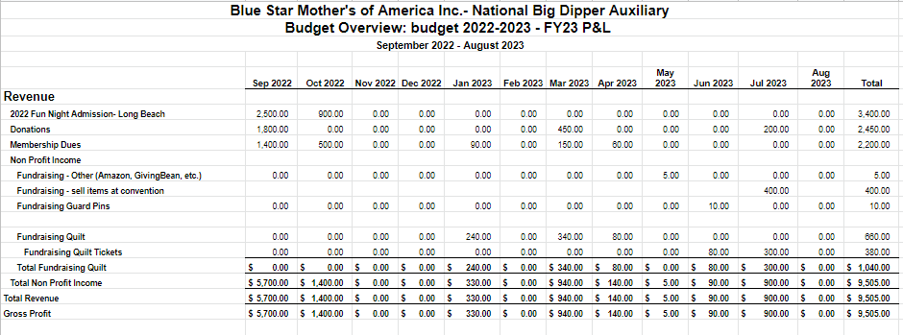
PROPOSED BUDGET 2022-2023

Slide 14
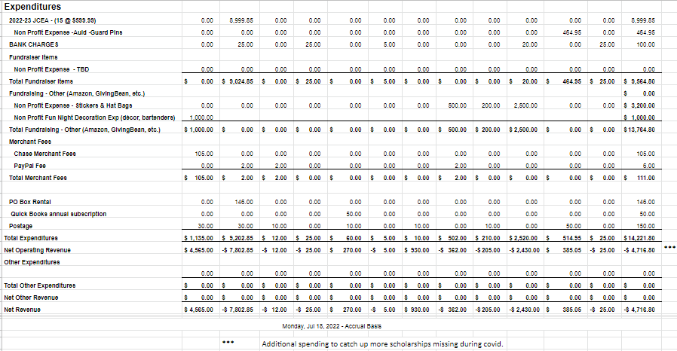
PROPOSED BUDGET 2022-2023

Slide 15
The Big Dipper is a national auxiliary of Blue Star Mothers of America, Inc. (BSMA) that came into being in Milwaukee, WI November 7, 1951 at National Convention. The objectives of the organization are threefold:
1) honoring outstanding members of the BSMA,
2) sponsoring a “FUN Night” at convention and
3) providing educational assistance to a Veteran, Active Duty Personnel or BSMA member; a child (grandchild) of a Veteran, Active Duty Personnel or BSMA member; or the spouse of a Veteran or active duty personnel.
The Josephine Calenda educational assistance fund was dedicated to the memory of Josephine Calenda of BSMA PA22 at National BSMA Convention in Lansing, MI in 1989.
Josephine, after many years of active service in BSMA, died that year while holding the office of National Big Dipper President.
The objective of Big Dipper Auxiliary was updated over the years to include Veteran(s) Spouse.

Slide 16
Persons applying for educational assistance must be
currently enrolled in a college or vocational school
pursuing a degree or certificate
at the time of award disbursement.

Slide 17
Determination of Educational Assistance will be based on the following factors listed below and each category will receive scores of 0-3

Slide 18
1. Letter of Recommendation- must be current, signed, dated and attached to this form to be considered complete.
2. Original Biographical Essay for fiscal year application. The same essay can be used at two levels (National and Department levels) in the same fiscal year. Prior essay submissions will not be accepted. Please write 350-450 word essay stating why you should be considered for Big Dipper Educational Assistance Funds. Include the course of study you plan to pursue and why; and how these funds would further your educational goals.
3. Active Duty (*see below) or Veteran
4. Child/Grandchild of BSMA member in good standing
5. BSMA member in good standing
6. Miscellaneous/Special circumstances

Slide 19
ELIGIBILITY/LIMITATIONS FOR ASSISTANCE AWARD
Applicant must meet one or more
of the following eligibility requirements:

Slide 20
*Active Duty U.S. Military, National Guard, Reserve Member;
Retired U.S. Military member or Veteran (Honorable Discharge status’);
Child or Grandchildren of Veteran (Honorable Discharge status’);
Child or Grandchildren of a BSMA member/ Blue Daisy in good standing;
Blue Star Mother of America, Inc. member in good standing;
Spouse of Veteran (Honorable Discharge status’)

Slide 21
THE FOLLOWING APPLICANTS ARE
NOT ELIGIBLE
FOR AN AWARD:

Slide 22
Anyone who has previously received the
Josephine Calenda Educational Award 2 times per level;
National (2 times) & Department (2 times)
Active Duty on continuing education for graduate degrees; included but not limited to enrollment in continuing education enrollment in tech schools/ military academies.
Those receiving pay to attend schooling are not eligible.
Continuing Educational Classes to maintain Certificate or License.

Slide 23
APPLICATION INSTRUCTIONS
The BSMA National Big Dipper Auxiliary and Josephine Calenda Educational Assistance Committee are not responsible for incomplete, lost or misdirected applications. No notification will be made of any incomplete applications or use of improper applications, submission must be on current application year form. Applications are not returned, all application information submitted becomes the property of the BSMA National/Department Big Dipper Auxiliary at the level they are submitted. Applications must be received no later than sixty (60) thirty (30) days before National/Department Convention to be considered eligible.
Deadline date:_________

Slide 24
Current Year application must be used and
include the ALL the following:
1. Applicant Checklist Sheet (Attached)
2. Applicant Information Sheet (Attached)
3. Proof of residency for applicant (example: Government issued ID by State of Legal Residence/permanent home. To be eligible for a Department level award you must be able to confirm State of Legal Residence/permanent home to the applying state award.)

Slide 25
5. Letter of recommendation from one of the following:
a. High School Teacher, Professor, Counselor, Employer, Pastor, Other Authority figure or Service Professional not related to you. (Family and Friend references are not accepted. Recommendation must include the author's company, school, title, etc. or on letterhead, current, signed, dated by its author and attached to this form to be considered complete.)
6. Original written biographical essay stating why you should be a recipient of Josephine Calenda Educational Assistance Award. Include any extenuating circumstances that you feel we should be made aware of. (A typed, 350-400-word essay on an 8 1⁄2 x 11 single sided double-spaced page with one-inch margins using Times New Roman 12- point font. Must be signed and dated.
7. A high school or higher educational transcript is required if graduated prior to 2022 but does not have to be sealed.
8. Must be signed off by Chapter President

Slide 26
AWARD RECIPIENT RESPONSIBILITIES
1. Recipients will be required to submit/provide an official proof of enrollment verification, or confirmation from registrar/bursar, and a completed, signed and dated Educational Press/Photo Release form following the announcement of awards per instructions in award letter. Depending upon award amount, a W-9 may be required and will be provided to you for issuance of 1099 MISC per IRS requirements.

Slide 27
2. An official enrollment verification from the educational institution’s registrar or bursar must be sent to the Financial Secretary and received no later than October 30th, of current year. Electronic verification through email will also be accepted per instructions in award letter. Any fee associated with this service is the responsibility of the applicant
3. Big Dipper Auxiliary Financial Secretary shall request a check from Big Dipper Auxiliary Treasurer in the full amount of the award payable to Recipient once the enrollment has been verified. Big Dipper Auxiliary Treasurer shall forward this check within 14 days of receiving all necessary information from Big Dipper Auxiliary Financial Secretary. All verified awards shall be sent out no later than December 31st of current year.
4. Any recipients required information requested not received prior to November 30th , of current year will result in the award being forfeited. Applicant is welcome to apply if they have not exceeded the twice per level limitation in subsequent years.

Slide 28
NUMBER AND AMOUNT OF AWARDS
The Committee will approve the total number of awards based on funds available. The amounts of assistance may vary annually and according to eligibility category.
The Educational Assistance Committee decisions are based on application scores. The decisions are final and cannot be challenged.
Not everyone may be awarded assistance. Applications must be signed by a current BSMA, Inc. Chapter President, then received by National/Department Big Dipper Auxiliary President at level applying, by the due date and meet all the requirements. In addition, applicants scores totaling below 70% will not be eligible for assistance but would be encouraged to apply in the future, provided the applicants have not already received maximum award limits.

Slide 29
**Selection notification will be made approximately 30 days following the close of Convention**, As stated & signed on the application:
I understand and agree the BSMA Big Dipper Auxiliary Josephine Calenda Educational Assistance Committee is solely responsible for the selection of the recipients of the Josephine Calenda Educational Assistance Award. All decisions are final and cannot be challenged. I agree that my signature on the application form authorizes the BSMA Big Dipper Auxiliary to release information regarding this application (including GPA, transcripts, etc.) to the Educational Assistance Committee as needed. I certify that all information provided with this application is accurate to the best of my knowledge, and the essay is entirely the applicant’s own effort. Amounts of assistance will vary annually and awards are based on funds available. BSMA Big Dipper Auxiliary is NOT responsible for lost, misdirected or incomplete items at any level. Communication will be with applicant only. For under 18 years, Parent/Guardian who signed application will be granted communication authority along with the minor applicant.
The Big Dipper Auxiliary is proud to provide educational assistance to worthy applicants and hopes to continue to do so for many years to come.
****OFFICIAL Use Only****

Slide 30
BLUE STAR MOTHERS OF AMERICA, INC. BIG DIPPER _ Auxiliary (Fill in Name of National or State Department) 2023 EDUCATIONAL ASSISTANCE APPLICATION
Name Age Male Female
Address Phone #
Street City State Zip-code
Email Address________________________________________________________________
Are you a Blue Star Mother? Yes No
Are you a Veteran? Yes No
If applicant is a son, daughter, grandson, or granddaughter of a Blue Star Mother
State BSM’S Name State Chapter #
Address Phone #
Email Address
Is applicant a son or daughter of a Veteran or an active Duty Service Member or Reservist? Yes No . If yes, state the following information:
(If you are a Veteran, complete the following about yourself):
Name of Veteran Branch of Service
Theater of Service Rank
(If served during Peace time, state – “PEACE TIME”)
Date of Service
Is this parent still living? Yes No

Slide 31
High School GPA: 1st year 2nd year 3rd year 4th year
State your college preference
State anticipated course of study College GPA for terms thus far attended. Please write a brief biography and state why you should be a recipient of Big Dipper Educational Assistance funds. (Please type and attach to this form)
Please include a letter of recommendation from one of the following:
High School Principal – Teacher/Professor – Pastor - Other Authority figure not related to you.
Date completed: Signature of Applicant
Approved by
Chapter President Name and Number of Chapter
***Application must be received by President of level of Big Dipper indicated on top of form 30 days prior
to respective convention. **
_________________________________________________________________________
*** FOR OFFICIAL USE ONLY *** DATE RECEIVED: __________ DATE REVIEWED: _____________________

Slide 32
BLUE STAR MOTHERS OF AMERICA, INC. BIG DIPPER AUXILIARY EDUCATIONAL ASSISTANCE APPLICATION CHECKLIST **USE THIS CHECKLIST AS YOUR COVER SHEET WHEN SUBMITTING AN EDUCATIONAL ASSISTANCE REQUEST** EDUCATIONAL ASSISTANCE APPLICANT’S INFORMATION NAME ____________________________________________________
Checklist:
BSMA Big Dipper Auxiliary Completed Educational Assistance Application
Current, Signed and Dated Letter of Recommendation from Principal, Teacher, Pastor, or other Authority figure not related to you.
Biographical Essay (350 - 450 words) Original, signed and dated
Once your application is complete, acquire the original signature of the local BSMA Chapter President and have her fill in the chapter’s name and number.
I understand and agree the BSMA Big Dipper Auxiliary Educational Assistance Committee is solely responsible for the selection of the recipients of the Josephine Calenda Funds and its decision is final.

Slide 33
MAIL ALL OF THE ABOVE TO: BSMA Big Dipper National Auxiliary, ________________________________ (to be considered for National Funds) Or apply mid to late summer to your state Department Big Dipper Auxiliary listed below.
BSMA Big Dipper MI Dept., ______________________________________________
BSMA Big Dipper OH Dept, ______________________________________________
*Selection notification to be made no less than 30 days following the close of Convention.
________________________________________________________________
Official Use Only
Date Received: Date Reviewed: ___________
Application Complete: Yes No

Slide 34
Standing Rules
These rules shall govern the
Big Dipper Auxiliary in all cases in
which they will apply and
are consistent with
the BSMA Governing Documents
and Robert’s Rules of Order.

Slide 35
Rules may be changed only at the National Convention by a majority vote.
“All BSMA members who are registered Big Dipper Auxiliary members and are members in good standing with BSMA in attendance at convention’s Big Dipper Annual Meeting shall constitute the voting membership of Big Dipper Auxiliary.”
Elections and installations of new Big Dipper Auxiliary officers shall be held at the BSMA Conventions.
Any BSMA member in good standing, may apply for and become a member of Big Dipper Auxiliary.
Annual membership dues shall be $10.00. Chapters with no Big Dipper Auxiliary Departments shall send the $10.00 and one copy of the application to the National Big Dipper Auxiliary Financial Secretary. The membership year runs concurrent with the BSMA membership year. Chapters belonging to states that have a Big Dipper Auxiliary Department, Dues are to be sent to the Department Big Dipper Auxiliary Financial Secretary along with two copies of the application. $5.00 and one copy of the application shall be retained in Department. $5.00 and the other copy of the application shall be sent to the Big Dipper Auxiliary National Financial Secretary.

Slide 36
Dues must be submitted using the official forms. These are to be supplied by the Big Dipper Vice President and are to be available on the Big Dipper Auxiliary page on the BSMA, Inc National website.
Big Dipper Auxiliary membership cards are available upon request.
The Big Dipper Auxiliary Executive Board shall consist of the most recently elected Big Dipper Auxiliary National/Department officers (President, Vice President, Recording Secretary, Financial Secretary, and Treasurer), Big Dipper Auxiliary Department Presidents and the three (3) most recent Past Big Dipper National/Department Presidents still retaining their membership in BSMA, Inc. in good standing. These members of the Big Dipper Auxiliary Executive Board are the only Big Dipper Auxiliary Board members with voting rights when the Board is in session
Elected Officers of the organization shall be the President, Vice President, Recording Secretary, Financial Secretary and Treasurer.

Slide 37
The President shall appoint a Chaplain, Historian, Patriotic Instructor, Sgt. At Arms, Parliamentarian, and the three (3) members of the Educational Assistance Committee and its Chair shortly after she is elected. She may appoint additional members to assist with the planning and implementation of the Annual FUN Night at Convention or any other committees and their chair as needed.
10. The Department Big Dipper Auxiliary Recording Secretary shall submit the newly elected Department Big Dipper Auxiliary officer list to the Big Dipper Auxiliary National Financial Secretary, with additional copies to be sent to the Big Dipper Auxiliary National President, Big Dipper Auxiliary National Vice President, BSMA Department President and the BSMA National President to be uploaded to the National website (The uploading will be dependent on whether the National Big Dipper Auxiliary web page provides a place to post it.) within 30 days of the Department Convention.

Slide 38
11. A Completed Educational Assistance Applications must be received by National/Department Big Dipper Auxiliary President no less than thirty (30) days prior to their Conventions.
12. A child(ren) and grandchild(ren) of a Veteran or BSMA member; a Veteran, a BSMA member or the spouse of a Veteran or active duty personnel are eligible to apply for educational financial assistance.
Active Duty Personnel
US Military Veteran
Child (ren)/ Grandchild (ren)/ Spouse of Active Duty or US Military Veteran
BSMA Member/ Blue Daisy in good standing
Child (ren) / Grandchild (ren) of BSMA Member/Blue Daisy in good standing

Slide 39
Once recipients of the Josephine Calenda Fund are chosen, a letter of congratulations will be sent by the National/Department Big Dipper Auxiliary President indicating they have been chosen as a JCEA award recipient. In that congratulatory letter we will ask them to provide, in a timely manner, enrollment verification for the school they will be/are currently attending. When that enrollment verification arrives, the check will be written and mailed to the recipient.
Assistance can be received up to four times. Award assistance may not exceed twice on the National level and may not exceed twice on Department level if eligible.
Funds from this Big Dipper Auxiliary organization shall be from dues and donations. Other projects must have the written permission of the Big Dipper Auxiliary President and the BSMA National President of the parent organization.
The Financial Policies of National Big Dipper Auxiliary shall reflect the BSMA, Inc. Financial Policies in place for the current fiscal year. National Big Dipper Auxiliary’s Financial Policies will also be utilized by each Big Dipper Auxiliary Departments.

Slide 40
19. An award maximum may be set to not exceed the IRS 1099 reporting amount; the number of awards will be dependent on the funds available. A letter will be sent with the award notifying the recipient of their responsibility to claim the award as income on their tax return based on any current IRS rules.
20. All awards shall be sent by December 31st to the qualified recipients that have supplied their proof of education enrollment.
21. All non-disbursed funds will remain in the account to be use for future years.
22. National Big Dipper Auxiliary shall follow all National BSMA, Inc. Organization election processes.

Slide 41
RUBIC 2022-2023

Slide 42
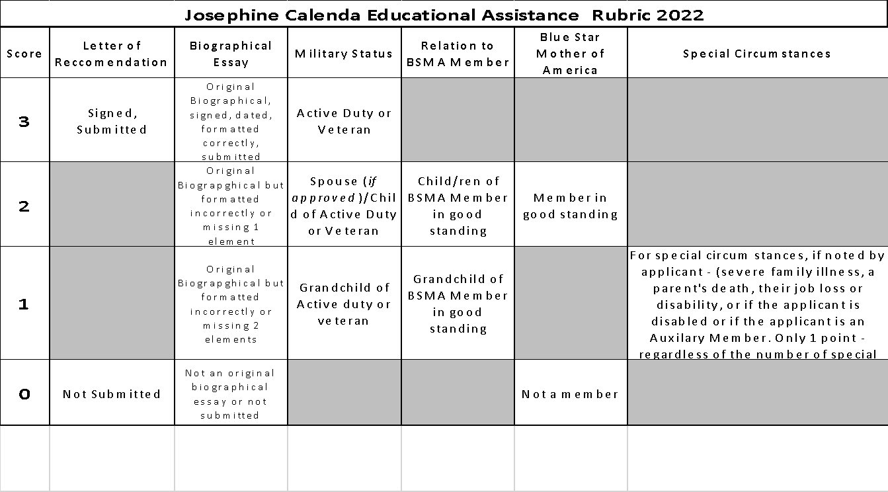

Slide 43
The “Big Dipper” Organization
Adopted at Milwaukee, Wisconsin November 7, 1951
As suggested by Ivah Z. Jones
Amended at Pittsburgh, Pennsylvania November 4, 1959
Marie Lynch, Big Dipper President
Erma Hoffman, Parliamentarian
Amended at Sault Ste. Marie, Michigan October 7, 1980
Frances Hanley, Chairman
Lucille Knoll, National Recording Sect.
Imogene Miller, 2nd Vice President Dept. of California
Amended at Orlando, Florida August 8, 2004
Elaine Mather, Big Dipper President
Joyce Fulford, Past National President
Big Dipper Parliamentarian:
Mary Susie Huffer, National 1st Vice President
Amended at Albuquerque, New Mexico August 3, 2007
Linda Humphrey, Big Dipper National President
Joyce Fulford, Past National President
Department of Michigan
Sue Grawey, Past Department President
Department of Michigan
Betty Stonner, National 1st V.P.
Amended at San Francisco, California Aug 16, 2013
Laura De Roo, Past National President Big Dipper
Marianna Sherman, Past Department President Department of Ohio
Ann Cordero National Big Dipper Treasurer
Amended at Cleveland, Ohio August 7, 2015
Lori Thueme, Big Dipper National President
Kade Rutherford, 1VP National Big Dipper
Judy Dorsey, National President
Amended at Manhattan, NY August 3,2017
Kade Rutherford, Big Dipper President
Theresa Koontz, 1VP National Big Dipper
Cyndi Ventura, National President
Amended at New Orleans, LA August 5,2021
Theresa Koontz, Big Dipper President
Tina Moses, 1VP National Big Dipper
Carla Brodacki, National President
Amended at Long Beach, California July __, 2022
Elizabeth Bohannon, Big Dipper President
Elizabeth Coyle, 1VP National Big Dipper
Stacy Anders, National President

Slide 44
Election
TIME

Slide 45
To maintain the Auxiliary we must seat a board.
Many of our current board has exhausted the time in office and must move on.
Please consider running for a position on the
National Big Dipper Board

Slide 46
ARTICLE VIII.
NATIONAL EXECUTIVE BOARD The NEB shall consist of the most recently Elected National Officers, Department Presidents and the three (3) most recent Past Presidents still retaining their membership in Blue Star Mothers of America, Inc. If any of the three (3) most recent Past National Presidents still retaining their membership in Blue Star Mothers of America, Inc. cannot or will not serve on the NEB; her position on the NEB will remain vacant and not be filled. All other Past NP’s will serve in an advisory role only to the NEB but will retain their right to vote at National Convention. The NEB shall administer the activities and business of this Corporation in the interim between National Conventions.

Slide 47
ARTICLE IX. ELECTIONS Section
1. All Members nominated for office shall be in good standing. Section
2. There shall be no campaigning for office or any demonstration during the Convention. Section
3. The NFS and the N1stVP shall verify the identity of each voting delegate. During elections, non-voting Members and all other non-voting attendees shall move to an area of the Convention hall designated by the NP. The NP shall call for the doors of the Convention hall to be secured by the Sergeant-At-Arms. No individual will be permitted to enter or leave the convention hall during elections. Section
4. A nomination committee, appointed by the NP, will receive nominations and qualifications for each position, to be distributed to the membership, no later than thirty (30) days before convention. Nominations may also be made from the floor without prior distribution being required. Verification that these nominees are members in good standing and meet the qualification for the position will be made prior to voting. Nomination speeches must be no longer than two (2) minutes and be limited to specific qualifications for the nominated office. Section
5. Nominees, except under extreme circumstances (such as temporary illness, accident, family emergency, natural disaster, or act of war or terrorism) must be present to accept the nomination. In the case of absence, a letter must be addressed to the NEB or the DEB prior to the Convention citing the office, qualifications for office, acceptance if nominated, and a detailed explanation of absence. Upon receipt of this letter, the candidate will be added to the ballot. Section
6. Delegates must be present in the Convention hall to vote. There will be no proxy or absentee voting. Section

Slide 48
7. The NP may represent any state. All remaining elected officers may represent any Department or Chapter. BSMoA, Inc.’s Bylaws Adopted and Approved by the 76th Annual Convention of the BSMoA, Inc. Effective 11 August, 2018 10 of 11
Section 8. Election of officers shall be by ballot.
Section 9. At the opening Board meeting, the NP and NEB shall appoint a Judge and three (3) Tellers for the Convention elections. The Judge should be a Past President, if possible. The Tellers should be chosen from different states. All ballots shall be counted in private and the Member with the majority announced as having been elected. If there is not a majority, the two (2) leading candidates remain on the ballot and a second (2nd) vote is taken. The candidate on the second (2nd) ballot with a majority is announced as having been elected. Ballots shall be secured by the NRS until the next Convention.
Section 10. An officer of the NEB or DEB shall hold office for a term of one (1) year, or until a successor is elected. The term of office begins immediately upon completion of the installation ceremony held immediately after elections. An officer may serve one additional term, or year, in the same office, whether consecutively or non-consecutively.
Section 11. An officer of a chapter shall hold office for a term of one (1) year, or until a successor is elected. The term of office begins immediately upon completion of the installation ceremony. An officer may serve additional terms in the same office, whether consecutively or non-consecutively as the need arises (upon the request and with the consent of her chapter).

Slide 49
ARTICLE X. ELECTED OFFICERS
Section 1. National Officers must have the following qualifications: a.) The newly elected NP must have served as an elected officer for at least one (1) full year on NEB, or have served as least one (1) full year as the Department President; b.) If the newly elected NP held any elected or appointed financial offices, such as Treasurer or Financial Secretary, Big Dipper and Yearbook positions at any level, she must resign from these duties immediately upon her acceptance of the higher office; c.) The Vice Presidents shall be nominated from National, Department, and Chapter officers; and d.) The newly elected NT or NFS must have served as a Finance Officer in a Department or Chapter, or have an accounting or financial background. Section 2. Department Officers must have the following qualifications: a.) The President must have served as an elected officer for at least one (1) full year on the DEB; b.) The VPs shall be nominated from Department or Chapter officers; and c.) The Treasurer or Financial Secretary must have either served as a Financial Officer in Department or Chapter or have an accounting background.

Slide 50
President
Qualifications: 1. NP must have served as an elected office at least one (1) full year on the NEB, or have served as least one (1) full year as the Department President; a. If the newly elected NP held any elected or appointed financial offices, such as NT or NFS, Big Dipper and Yearbook positions at any levels, she must resign from these duties immediately upon her acceptance of the higher office. 6 of 48 BSMoA, Inc.’s Leadership Handbook Adopted and Approved by the National Executive Board Effective 11 August, 2018 2. The NP must be thoroughly familiar with every National Officer’s elected and appointed, to include National Chairpersons, and National Committee’s roles and duties; and (the NP must be thoroughly familiar with every National Officer’s elected and appointed role and duties, to include National Committee Chairpersons and Committee Members.) 3. The NP must thoroughly understand or seek to obtain legal guidance to understand Federal Law as applicable to a IRC incorporated charity, understand IRS Regulation, the Charter, Governing Documents, Rituals and Ceremonials, Affiliation Contracts, policies to include Parliamentary Procedure, and their relative order of governing precedence.

Slide 51
NOMINATIONS:

Slide 52
1VP
Key capabilities:
1. Member in good standing; 2. Computer proficiency; 3. Proficient knowledge of Microsoft Excel; 4. Proficient knowledge of Microsoft Word; 5. Excellent communication skills, verbal, phone, email; 6. Utilize mass mailing feature from the Corporation’s Website; 7. Ability to proficiently use the Corporation’s Database to input data and pull data for reports; 8. Technical writing skills to accurately communicate how the Chapters and Departments are to update the membership and submit reports to the Corporation’s Database; 9. Ability to work in a team environment; 10. Good working knowledge for the use of Parliamentary procedure in all meetings; and 11. Professionalism at meetings and when interacting with all members.

Slide 53
NOMINATIONS:

Slide 54
RECORDING SECRETARY
Key capabilities:
1. Member in good standing; 2. Computer proficiency skills; 20 of 48 BSMoA, Inc.’s Leadership Handbook Adopted and Approved by the National Executive Board Effective 11 August, 2018 3. Proficiency with Microsoft Word and Microsoft Excel spreadsheets; 4. Knowledge of parliamentary procedure and the most current version of Roberts Rules of Order for recording minutes 5. Accurately record the minutes of the meetings; 6. Ability to proficiently use and pull information from Corporation’s Website and Database; 7. Good oral and written communication skills; 8. Ability to work productively and cohesively in a team environment; 9. Availability to be present to record meetings when required; 10. Working knowledge of Parliamentary meeting procedure protocol; 11. Professionalism at meetings and when interacting with all members; 12. Basic computer data entry skills; and 13. Email discussion skills.

Slide 55
NOMINATIONS:

Slide 56
FINANCIAL SECRETARY
Key capabilities:
1. Member in good standing; 2. Prior service as a financial officer for at least one (1) Chapter or Department term year demonstrating excellent past performance in best practice financial recordkeeping; 3. Computer proficiency; 4. Proficient knowledge of Microsoft Excel and Microsoft Word; 5. Ability to become proficient in QuickBooks Online Software; 6. Excellent communication skills, oral, written, phone, email; 7. Knowledge of best practice accounting and SFAF following IRC guidelines; 8. Understanding of her role and duty as a fiduciary of a non-profit charity; 9. Ability to proficiently use the Corporation’s Database and QuickBooks to input 23 of 48 BSMoA, Inc.’s Leadership Handbook Adopted and Approved by the National Executive Board Effective 11 August, 2018 data and pull data for reports; 10. Ability to work in a team environment; 11. Participate in meetings; 12. Professionalism at meetings and when interacting with all members; and 13. Participation in meetings following Parliamentary meeting protocol.

Slide 57
NOMINATIONS:

Slide 58
TREASURER
Key capabilities
1. Member in good standing; 2. Computer proficiency skills; 3. Proficiency with Microsoft Word and Microsoft Excel; 26 of 48 BSMoA, Inc.’s Leadership Handbook Adopted and Approved by the National Executive Board Effective 11 August, 2018 4. Knowledge of “Best Practices Accounting” and SFAF where applicable to the Corporation; 5. Good oral and written communication skills; 6. Ability to work in a team environment; 7. Working knowledge of Parliamentary meeting procedure protocol; 8. Professionalism at meetings and when interacting with all members; 9. Basic computer data entry skills; 10. Knowledge of preparing a budget; and 11. Email discussion skills.

Slide 59
NOMINATIONS:

Slide 60
2022 - 2023 National Big Dipper Elected Board

Slide 61
President: 1st Vice Pesident Recording Secretary Financial Secretary Treasurer:

Slide 62
THANK YOU FOR ALLOWING US TO SERVE AS YOUR 2021-2022 NATIONAL BIG DIPPER BOARD
On Behalf of the out going National Big Dipper Board, we would like to “Thank You” for the support you have provided thru this continued pandemic time & prior years.
We look forward to the National Big Dipper
remaining a strong auxiliary of our parent organization.
It has been our pleasure to add the FUN to the National Blue Star Mothers of America, Inc. organization. We wish the 2022-2023 Board & Membership a successful experience.
We are here to mentor in anyway we can.
Elizabeth B, Liz C, Deb , Charla, Theresa, Pat, Gloria, Kade

