Slide 1
Financial Presentation
August 2021 National BSMA Convention – New Orleans, LA

Slide 2
Financial Presentation Content
Audit FYE 08/31/2019
Audit FYE 08/31/2020
Proposed Budget FYE 08/31/2022
Proposed Financial Policies FYE 08/31/2022
Convention Body approved 30% Donation selections
Informative
Session

Slide 3
Audit FYE 08/31/2019
Auditor’s Opinion
“Balance Sheet”
“Income Statement”

Slide 7
Year end Cash = $191,540

Slide 8
“Net Income” = $5,615

Slide 9
Financial Presentation Content
Audit FYE 08/31/2019
Audit FYE 08/31/2020
Proposed Budget FYE 08/31/2022
Proposed Financial Policies FYE 08/31/2022
Convention Body approved 30% Donation selections
Informative
Session
P

Slide 10
Audit FYE 08/31/2020
Auditor’s Opinion
“Balance Sheet”
“Income Statement”

Slide 14
Year end Cash = $227,917

Slide 15
“Net Income” = $21 098

Slide 16


Slide 17
Financial Presentation Content
Audit FYE 08/31/2019
Audit FYE 08/31/2020
Proposed Budget FYE 08/31/2022
Proposed Financial Policies FYE 08/31/2022
Convention Body approved 30% Donation selections
Informative
Session
P
P

Slide 18
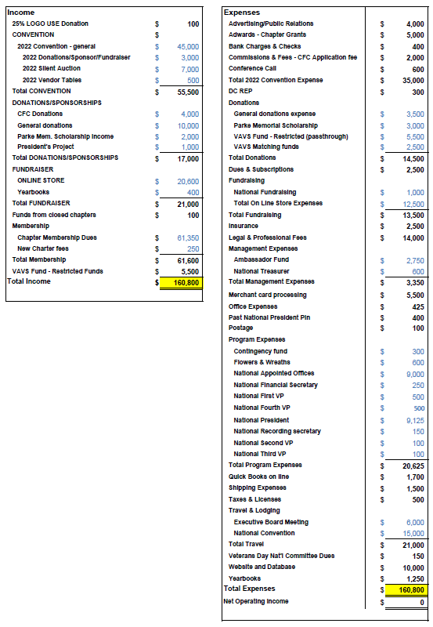
Please follow along with the discussion by looking at and notating the copy in your folder
Please hold your questions until the end
We will put the spreadsheet up on the screen as opportunity permits
We are proposing a Balanced Budget

Slide 19
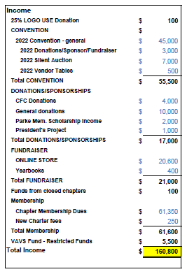
Proposed Income
Changes from previous Budget:
25% Logo Use up to $100 from $50
Online Store increased $875 to $20,600
Chapter Membership dues decreased by $2,650
Total Proposed Income = $160,800

Slide 20
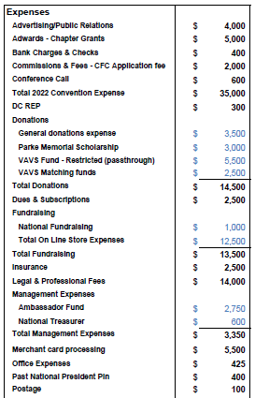
Proposed Expenses (1 of 2)
Changes from previous Budget:
Advertising down $1,000 to $4,000
Bank & check charges increased by $100 to $400
Commissions & Fees (CFC) increased by $1,000 to $2,000
Conference call costs increased by $350 to $600
Dues & Subscriptions increased by $2,175 to $2,500
Total Online store expenses increased by $500

Slide 21
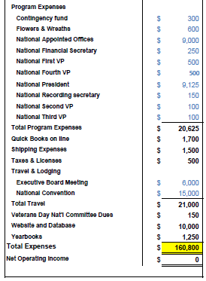
Proposed Expenses (2 of 2)
Changes from previous Budget:
Nat’l Appointed Offices increased $150
Nat’l President increased $5
QuickBooks online increased $20
Veterans Day Nat’l Comm Dues decreased $125
Website and Database increased $5,000
Total Proposed Expenses = $160,800

Slide 22


Slide 23
Financial Presentation Content
Audit FYE 08/31/2019
Audit FYE 08/31/2020
Proposed Budget FYE 08/31/2022
Proposed Financial Policies FYE 08/31/2022
Convention Body approved 30% Donation selections
Informative
Session
P
P
P

Slide 25
We will be going over just the CHANGES.
Notate the copy in your folder with your questions or concerns.
We will address your questions at the end.
The goal is to be able to approve this document as a whole.

Slide 26
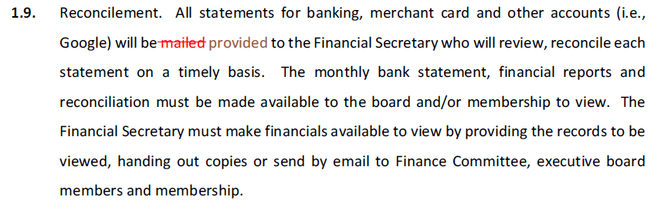
Sec 1.9 – Page 7 of 18
Topic: Internal Control – Reconcilement of bank accounts

Slide 27
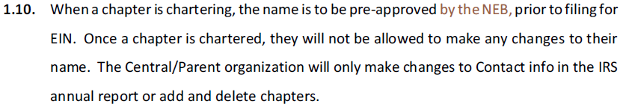
Sec 1.10 – Page 7 of 18
Topic: Internal Control – Chapter Name

Slide 28
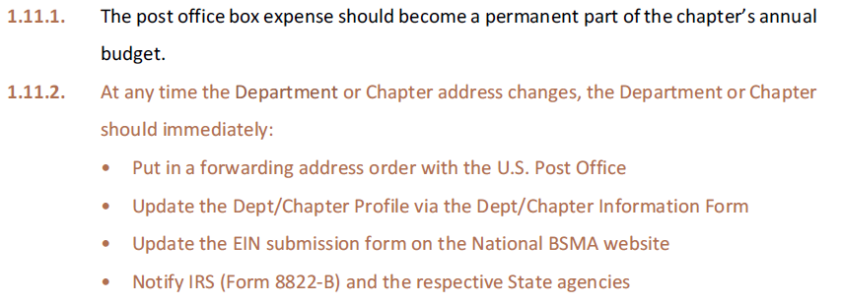
Sec 1.11.1, 1.11.2 – Page 8 of 18
Topic: Internal Control - Permanent Address

Slide 29
Sec 1.12 – Pages 8 & 9 of 18
Topic: Internal Control - Uncashed Checks
1.12. Uncashed Checks - Outstanding checks should not remain on the books for more than 180 days without reason. If the Payee can be contacted and confirm the check is lost, the original check is to be voided and a new check issued.
1.12.1. 90 days outstanding: Treasurer is to use every means available to contact the Payee keeping a record of emails, phone call attempts or letters sent.
1.12.2. 180 days outstanding:
A) Treasurer shall make one final attempt to contact the Payee and locate the missing uncashed check. Communication must be documented.
B) At 200 days:
1) If Payee is a BSMA chapter, auxiliary or member, the original check will be voided and the funds will revert to the issuing organization with no further claim of payment.
2) If Payee is a Vendor
a) Original check will be voided
b) Notice will be given and a check will be issued to the respective State treasurer, department of revenue or taxing agency that deals with escheat laws and unclaimed property in the state in which the Payee resides. (Reference The National Association of Unclaimed Property Administrators [NAUPA] website: https://unclaimed.org).

Slide 30
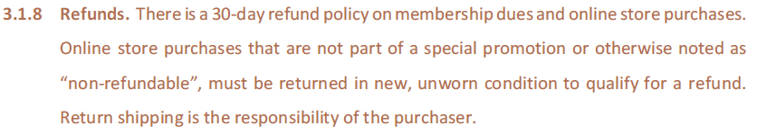
Sec 3.1.8 – Page 11 of 18
Topic: Expenditures Policies - Refunds

Slide 31
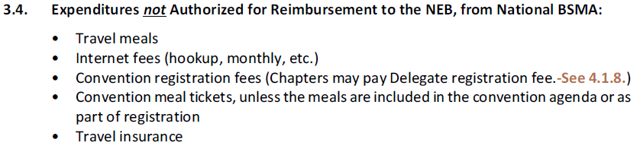
Sec 3.4 – Page 13 of 18
Topic: Expenditures Policies – Expenditures NOT Authorized

Slide 32
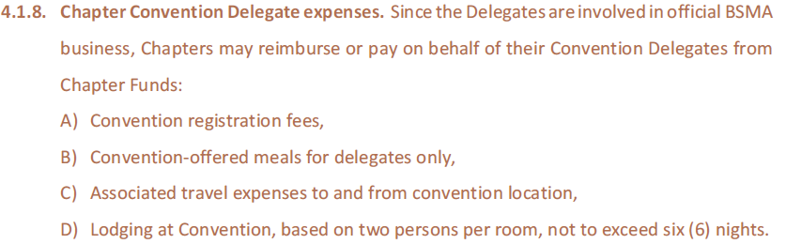
Sec 4.1.8 – Page 16 of 18
Topic: Expenditures Policies – Chapter Convention Delegate expenses

Slide 33
Time for Questions, Concerns, Proposed Changes
We will take these in the order in which they were presented

Slide 34


Slide 35
Financial Presentation Content
Audit FYE 08/31/2019
Audit FYE 08/31/2020
Proposed Budget FYE 08/31/2022
Proposed Financial Policies FYE 08/31/2022
Convention Body approved 30% Donation selections
Informative
Session
P
P
P
P

Slide 36
Donation Selection
6.1. Convention delegates may approve a donation up to 30% of the annual net income to a 501(c)3 Organization supporting our Mission, as the recipient, (YTD 6/30 used for estimating purposes only) if the National BSMA organization is financially stable. The donation is to be allocated to up to three (3) different 501(c)3 Projects, as chosen by Convention Body. The final donation amounts will be determined based on the year end audited financial statements.

Slide 37
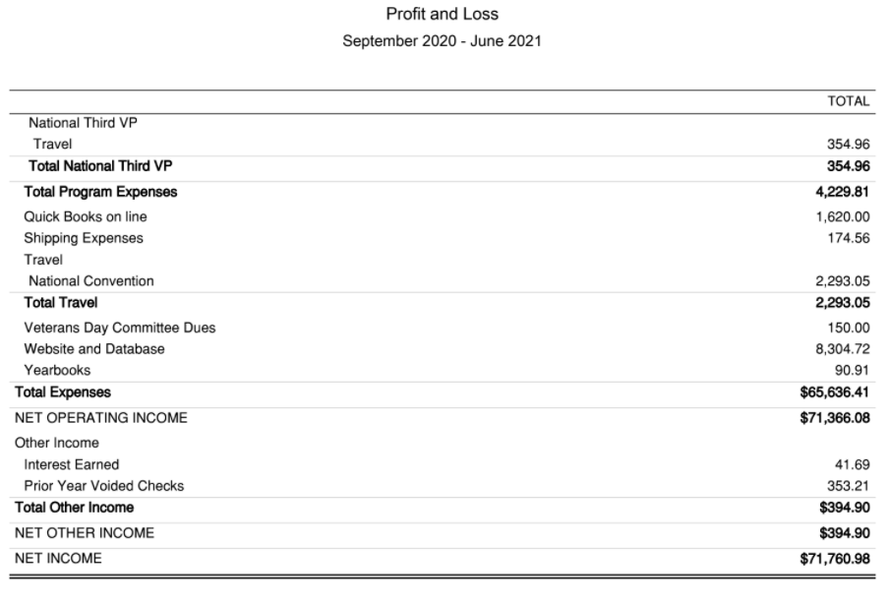
…YTD 6/30/2021 used for estimating purposes Only
A WORD OF CAUTION! – as of June 30th we had NOT paid a substantial part of the Convention expenses yet but had recorded >$54,000 in Convention income.
Do not get your hopes up thinking we’re able to give away “thousands of dollars”. The actual amounts will be determined based on the Audited financial statements at year end.

Slide 38


Slide 39
Financial Presentation Content
Audit FYE 08/31/2019
Audit FYE 08/31/2020
Proposed Budget FYE 08/31/2022
Proposed Financial Policies FYE 08/31/2022
Convention Body approved 30% Donation selections
Informative
Session
P
P
P
P
P

Slide 40
Maintaining your exempt status - what can jeopardize it?
References: IRS Publication 4221-PC (Rev.3-2018); https://www.StayExempt.irs.gov; https://www.irs.gov/charities-non-profits/life-cycle-of-an-exempt-organization; https://www.stayexempt.irs.gov/home/resource-library/virtual-small-mid-size-tax-exempt-organization-workshop

Slide 41
Maintaining your exempt status - what can jeopardize it?
References: IRS Publication 4221-PC (Rev.3-2018); https://www.StayExempt.irs.gov; https://www.irs.gov/charities-non-profits/life-cycle-of-an-exempt-organization; https://www.stayexempt.irs.gov/home/resource-library/virtual-small-mid-size-tax-exempt-organization-workshop
Required Filings - Inadequate Recordkeeping
Must keep financial records of money coming in and money going out (commonly known as a Profit & Loss statement)
Must keep employment tax records IF you have an employee (not applicable to most if not all of our chapters)
Asset records of investments, buildings, furniture, vehicles, etc. (When & how acquired, used and disposed of; Purchase price, Sales price, Cost of any improvements)
IRS requires that you maintain all receipts, etc for at least 3 years after the date your Form 990 was filed. Best practice - scan all back up documentation after 4 years and keep the main financial statements, Form 990 and proof of filing with the Chapter’s permanent records (meeting minutes, charter, annual compliance, etc.)
Must use a consistent accounting method and fiscal year

Slide 42
Maintaining your exempt status - what can jeopardize it?
References: IRS Publication 4221-PC (Rev.3-2018); https://www.StayExempt.irs.gov; https://www.irs.gov/charities-non-profits/life-cycle-of-an-exempt-organization; https://www.stayexempt.irs.gov/home/resource-library/virtual-small-mid-size-tax-exempt-organization-workshop
Required Filings - Failure to file Form 990 for Form 990EZ
This is due to IRS by the 15th day of the 5th month after your year end - ie January 15th
Nat’l BSMA requires it be filed by December 1st.
Intervening in Political campaigns, involvement in Political activities or legislative activites (lobbying):
“Under the Internal Revenue Code, all section 501(c)(3) organizations are absolutely prohibited from directly or indirectly participating in, or intervening in, any political campaign on behalf of (or in opposition to) any candidate for elective public office. Contributions to political campaign funds or public statements of position (verbal or written) made on behalf of the organization in favor of or in opposition to any candidate for public office clearly violate the prohibition against political campaign activity. Violating this prohibition may result in denial or revocation of tax-exempt status and the imposition of certain excise taxes.

Slide 43
Maintaining your exempt status - what can jeopardize it?
References: IRS Publication 4221-PC (Rev.3-2018); https://www.StayExempt.irs.gov; https://www.irs.gov/charities-non-profits/life-cycle-of-an-exempt-organization; https://www.stayexempt.irs.gov/home/resource-library/virtual-small-mid-size-tax-exempt-organization-workshop
Failure to register with your State, County or Local governments:
Each state has laws regulating fundraising - as well as how you go about soliciting donations. These include that your register your organization, special rules for when fundraising may involve raffles, lotteries or gaming (check into Gambling restrictions.) and filing financial reports.
Link to State Income Filing Requirements (by State): https://www.bluestarmothers.org/chapter-and-department-resources
This contains what your National BSMA Finance Committee has been able to obtain for each and every state. (Help us keep this up to date.)

Slide 44
Required Disclosures https://www.stayexempt.irs.gov/se/files/downloads/Required_Disclosures_Print_for_PDF.pdf
Public Inspection Rules
Annual returns for 3 years after the due date (not required to disclose donor names - just amounts and nature of the contribution)
Your application for exemption
The determination letter from the IRS that shows your exempt status (Nat’l letter available on our website.)
Available immediately is best, but within two weeks of the request
You can charge a reasonable fee for copies - better yet, post your information online and refer the requester to a specific portion of your website

Slide 45
Required Disclosures https://www.stayexempt.irs.gov/se/files/downloads/Required_Disclosures_Print_for_PDF.pdf
Quid Pro Quo (“something for something”)
. When a donor makes a contribution to an organization and they receive a good or service in return for their donation, they’ve made a quid pro quo contribution. If that donation is greater than $75 and you give the donor something in return, you must disclose the value of that item or service to the donor. (Think Crab feed at one of your fundraisers.)
. Exceptions: Insubstantial goods or services that you provide (@$11.25 or less) to donors in exchange for contributions - these are considered so small you don’t have to document them separately. (Think pins, magnets, coffee mugs, etc.)

Slide 46
Required Disclosures https://www.stayexempt.irs.gov/se/files/downloads/Required_Disclosures_Print_for_PDF.pdf
Non-Quid Pro Quo Acknowledgments
. Technically, if you don’t give a donor something in return for his or her contribution, you don’t have a disclosure requirement.
. However, Donors cannot claim a tax deduction for any contribution unless they maintain documentation for the amount donated. This is usually in the form of a written acknowledgment from you (and if over $250 - has to be from you.) Examples are on the Nat’l BSMA website.
. Must indicate the name of your organization; date of the contribution; the cash contribution amount; the description (but not value) of any noncash contributions; a statement that no goods or services were provided by the organization in return for the donation, if that was the case - or a description and good faith estimate of the value of goods or services, if any, that you provided in return for the contribution.

Slide 47
Reminders based on BSMA Governing Docs & Financial Policies
Chapter Presidents - Warning!
Training Videos
Get ready for Annual Compliance
It’s not “your” chapter or “your” money. You are a member just like everyone else, except that you’ve been tasked with the additional responsibility to make sure the goals and mission of your chapter are carried out efficiently and legally.
Chapter Financial Officers Zoom Meeting and other resources under Training Videos on the national website: https://www.bluestarmothers.org/training-videos
Statement of Income and Expense for the entire year
All pages of your 8/31 bank statements
Form 990 filed
State and local licenses and filings

Slide 48

Reminders based on BSMA Governing Docs & Financial Policies
Games of Chance
Raffles, lotteries, bunco, bingo
Know our BSMA Policies
Budget, Budget, Budget
Check with your State to know if registration of any type is required before conducting a fundraiser that involves games of chance. Some states have registration limits based on the value of the goods being awarded. It’s your responsibility to know the rules.
“But we’ve always
done it this way!”
It is a guide.
It is formed with the input from all members.
It eliminates redundant discussions throughout the year.
It is a measuring rod for how well you did in comparison to what you were expecting.

Slide 49

Stay true to our Mission
National Charter - Section 3 The purposes of the corporation shall be: To perpetuate the Blue Star Mothers of America, Inc., and the memory of all the men and women who have served our country as members of the Armed Forces; the further object of this organization shall be patriotic, educational, social, and for service; to maintain true allegiance to the Government of the United States; to educate our members and others not to divulge military, naval, or other Government information; to assist in veterans’ ceremonies, to attend patriotic rallies and meetings; to foster true democracy; to care for the unsupported mothers who gave their sons (and daughters) to the service of the Nation; to aid in bringing about recognition of the need of permanent civilian defense for each community and to ever be alert against invasion of un-American activities; to uphold the American institutions of freedom, justice, and equal rights, and to defend the United States from all enemies.

Slide 50


Slide 51
Financial Presentation
Thank you for your attention!
August 2021 National BSMA Convention – New Orleans, LA

